Slide 1


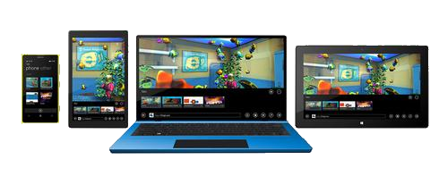
SQLite Local Storage in UWP
Using SQLite in Universal Windows Platform

Slide 2

Table of Contents
What is SQLite?
Setting up Visual Studio 2015 for development of UWP applications that use SQLite
Create/Open Database
Create Tables
CRUD operations on records
Create record/s to table
Retrieve records
Update records
Delete records
Drop a table

Slide 3
What is SQLite?
In-process library that implements a self-contained, serverless, zero-configuration, transactional SQL database engine
The library size is less than 500KiB
Reads and writes directly to ordinary disk files
The database file format is cross-platform
Free for use for any purpose
The most widely deployed database

Slide 4
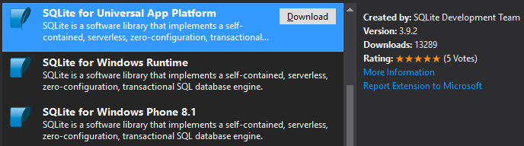
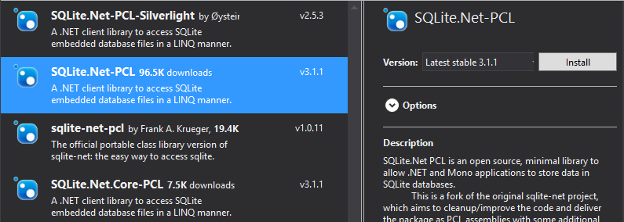
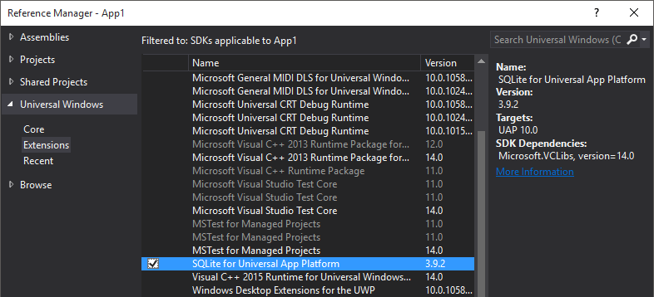
Setup VS for SQLite
Visual Studio 2015 Update 1 or higher
Install SQLite for Universal App Platform
Install NuGet Package SQLite.Net-PCL and SQLite.Net.Async-PCL
Add reference to SQLite for Universal App Platform

Slide 5
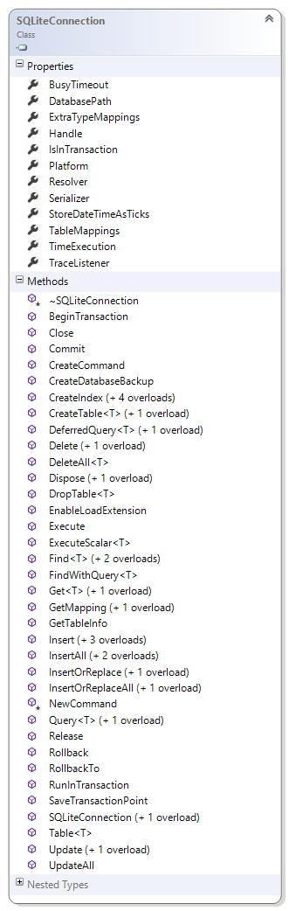
Create/Open Database
To open a database
Will be created if don't exist
var dbFilePath = Path.Combine( ApplicationData.Current.LocalFolder.Path, "db.sqlite");
var connectionFactory =
new Func<SQLiteConnectionWithLock>(
() => new SQLiteConnectionWithLock( new SQLitePlatformWinRT(), new SQLiteConnectionString( dbFilePath,
storeDateTimeAsTicks: false) ) );

Slide 6
Create Table – define model
It’s possible to decorate the class and the properties with attributes defined in the SQLite.Net-PCL library
Class Attributes
[Table(Name)]
Property attributes
[AutoIncrement]
[PrimaryKey]
[Column(Name)]
[Indexed] | [Indexed(string name, int order)]
[Unique]
[Ignore]
[MaxLength(int length)]
[Collation(string name)]
[NotNull]

Slide 7
Create Table
Create single table
Create multiple tables at once
If table is not founded in the database it will create it
If the class that represent the table row has changed, the method will try to update the SQLite table
Only the adding of new columns is supported
var connection = this.GetDbConnectionAsync();
await connection.CreateTableAsync<UserItem>();
var connection = this.GetDbConnectionAsync();
await conn.CreateTablesAsync<Model1, Model2, Model3>();

Slide 8

Create/Open Database
Demo

Slide 9
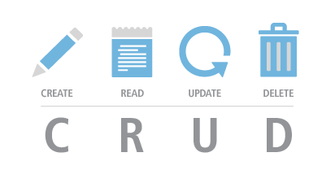
CRUD Operations

Slide 10
Create/Update records
Add single record to a table
Create records to a table
Any IEnumerable collection can be added to the table
Update record
Delete records
await connection.InsertAsync(new Article());
await connection.InsertAllAsync(new List<Article>());
await connection.UpdateAsync(model);
await connection.DeleteAsync(model);

Slide 11
Retrieve records
Query directly a table object using Linq
Using the connection query method
The SQL command can contain parameters
AsyncTableQuery<Article> query = conn.Table<Article>()
.Where(x => x.Title.Contains(title));
List<Article> result = await query.ToListAsync();
List<Article> articles = await connection
.QueryAsync<Article>("SELECT * FROM Articles");
List<Article> articles = await connection
.QueryAsync<Article>("SELECT Content FROM Articles WHERE Title = ?", new object[] { "param1, param2" });

Slide 12

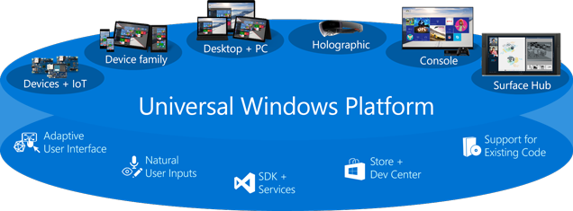
CRUD Operations
Demo

Slide 13
SQLite Local Storage in UWP
?
?
?
?
?
Questions?
?
?
?
?
?
http://academy.telerik.com

